Slide 1

Thursday, March 29th
6:15 PM
Food will be provided

Slide 2


Slide 3
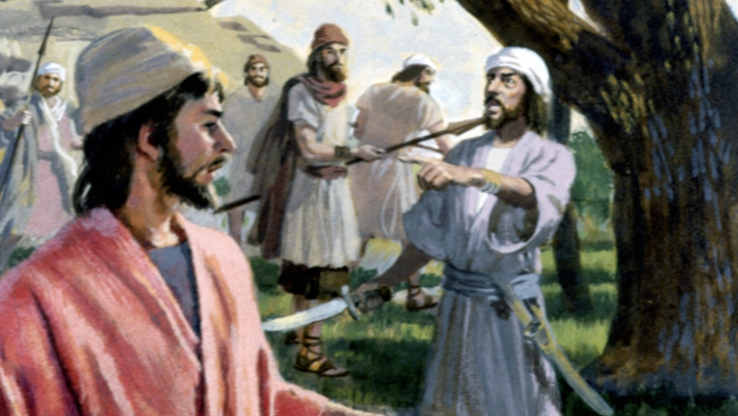
Crazy in Control
1 Samuel 14:24-52

Slide 4

Saul’s foolish fast.
He implemented a forced fast.
Saul’s pride is manifesting.
Matthew 12:34b …for out of the abundance of the heart the mouth speaketh.
When a leader gets off track with legalistic religion.

Slide 5
Isaiah 29:13 Wherefore the Lord said, Forasmuch as this people draw near me with their mouth, and with their lips do honour me, but have removed their heart far from me, and their fear toward me is taught by the precept of men:
Matt 7:15 Beware of false prophets, which come to you in sheep's clothing, but inwardly they are ravening wolves.

Slide 6
Saul proclaims a stupid curse against anyone that doesn’t face their battle by HIS mandate.
Result:
  The people obey because they fear Saul.
  Proverbs 29:25 The fear of man bringeth a snare:
  God’s people are distressed! (vs 24)
  They don’t have strength for the fight.

Slide 7
Jonathan’s walk of faith.

Slide 8
Psalm 119:103-104 How sweet are thy words unto my taste! yea, sweeter than honey to my mouth! 104 Through thy precepts I get understanding: therefore I hate every false way.
Proverbs 24:13-14 My son, eat thou honey, because it is good; and the honeycomb, which is sweet to thy taste: 14 So shall the knowledge of wisdom be unto thy soul: when thou hast found it, then there shall be a reward, and thy expectation shall not be cut off.

Slide 9
Receiving God’s Word “enlightens” our eyes.
2 Corinthians 4:4 In whom the god of this world hath blinded the minds of them which believe not, lest the light of the glorious gospel of Christ, who is the image of God, should shine unto them.

Slide 10
Amos 8:11 Behold, the days come, saith the Lord GOD, that I will send a famine in the land, not a famine of bread, nor a thirst for water, but of hearing the words of the LORD:
Psalm 119:18 Open thou mine eyes, that I may behold wondrous things out of thy law.
Psalm 119:19 I am a stranger in the earth: hide not thy commandments from me.

Slide 11
Saul proclaims a stupid curse against anyone that doesn’t face their battle by HIS mandate.
Result:
  The people obey because they fear Saul.
  Proverbs 29:25 The fear of man bringeth a snare:
  God’s people are distressed! (vs 24)
  They don’t have strength for the fight.
  The people are faint.

Slide 12
Jonathan’s statement of faith.

Slide 13
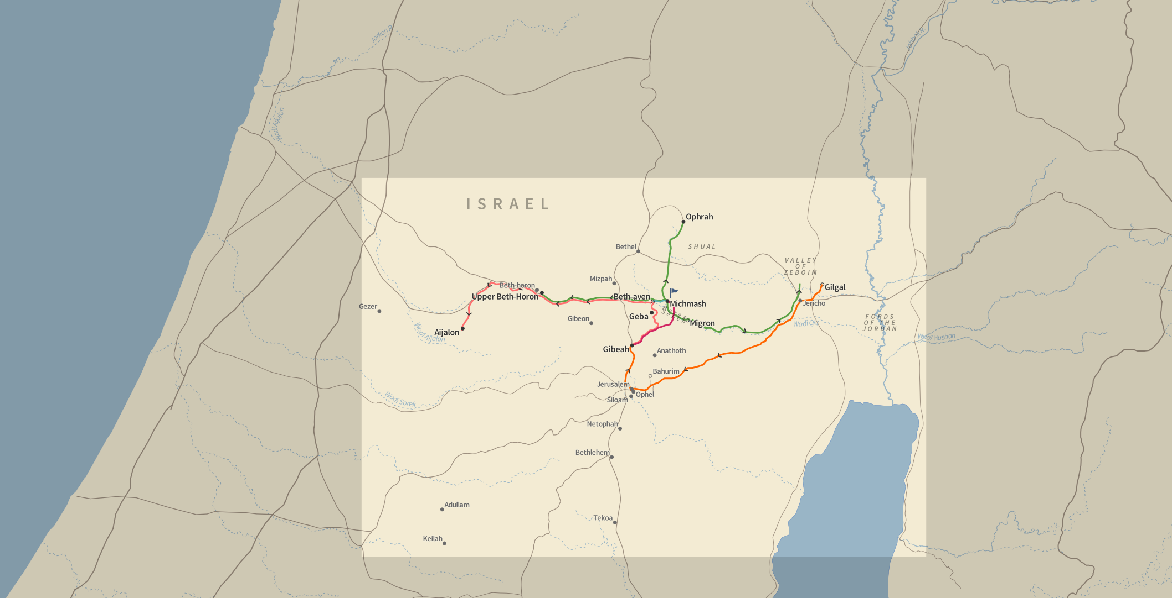

Slide 14
Joshua 7:25 And Joshua said, Why hast thou troubled us? the LORD shall trouble thee this day. And all Israel stoned him with stones, and burned them with fire, after they had stoned them with stones.
Achan took, Saul withheld. Both troubled Israel.
Prov 11:17 The merciful man doeth good to his own soul: but he that is cruel troubleth his own flesh.

Slide 15
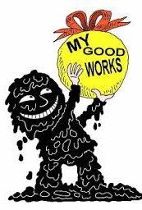
Legalism
Manmade rules always trouble God’s people.
When people cannot keep up the legalistic expectations, many just give up and live completely for the flesh.

Slide 16
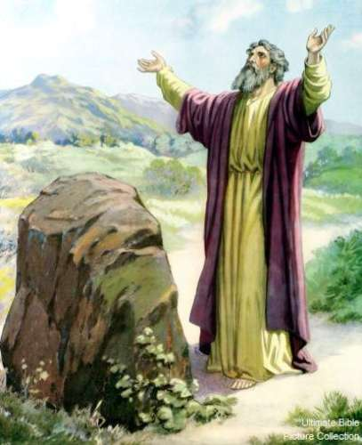
Saul’s solution to his legalistic failure
When a psycho gets on fire with false religion.

Slide 17
Leviticus 17:10-14 And whatsoever man there be of the house of Israel, or of the strangers that sojourn among you, that eateth any manner of blood; I will even set my face against that soul that eateth blood, and will cut him off from among his people. 11 For the life of the flesh is in the blood: and I have given it to you upon the altar to make an atonement for your souls: for it is the blood that maketh an atonement for the soul.

Slide 18
“Saul was feebly trying to turn a gastronomical orgy into a worship service, but he didn’t succeed too well. The men were famished and more interested in eating than in worshiping the Lord.” – Wiersbe

Slide 19
Saul’s solution to his legalistic failure
When a psycho gets on fire with false religion.
Saul isn’t accountable. Instead he is surrounded by “yes men.”

Slide 20
1 Corinthians 11:1 Be ye followers of me, even as I also am of Christ.
Proverbs 3:5-6 Trust in the LORD with all thine heart; and lean not unto thine own understanding. 6 In all thy ways acknowledge him, and he shall direct thy paths.

Slide 21
Saul Called. God didn’t answer.
Why?
Saul is full of himself.
Saul thinks that his commands (vs24) are God’s Word. Presumption!
Saul is again, blaming others for his sin.
Saul throws up another evil oath! He is willing to kill his own son.
Saul was troubling Israel.
Saul led Israel into division, allowing the Philistines to regroup! (vs52)

Slide 22
2 Corinthians 2:11 Lest Satan should get an advantage of us: for we are not ignorant of his devices.

Slide 23
2 Samuel 8:14b -15 And the LORD preserved David whithersoever he went. 15 And David reigned over all Israel; and David executed judgment and justice unto all his people.

